Slide 1
Electronic Signatures & Digital IDs
Creating a Secure Digital ID in Adobe Acrobat and Reader

Slide 2
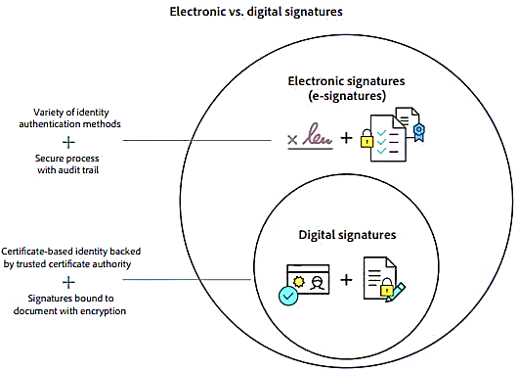
Electronic Signature vs Digital ID
Electronic Signatures use a wide variety of identity authentication methods
Signature in email, scanned ink, voice, video, etc.
Proof of signing uses a secure process that includes an audit trail and final document
Digital IDs use a specific method to sign documents electronically
Certificate-based identity backed by trusted certificate authority
Signatures bound to document with encryption
Notes:
Electronic Signature
The downfall of electronic signatures is that they aren’t regulated like digital signatures are.
It’s up to each vendor to make their own standards, and you have to take their word for it when they say their signatures are secure.
Electronic signatures don’t have the secure coding that Digital IDs have.
Electronic signatures are essentially just images placed on a document and they can’t show if someone tampers with the document after signed.
Types of electronic signatures:
Scanned image of an ink signature
Mouse squiggle on a screen
Hand-signature on a tablet using your finger or stylus
Signature at the bottom of your email
Type name
Video signature
Voice signature
Clicking an “I Agree” checkbox
Digital ID
A digital ID is a type of electronic signature that offers more security than a traditional electronic signature.
When you sign a document with a digital signature, the signature links a “fingerprint” of the document to your identity.
Then that information is permanently embedded into the document, and the document will show if someone comes in and tries to tamper with it after you’ve signed it.

Slide 3
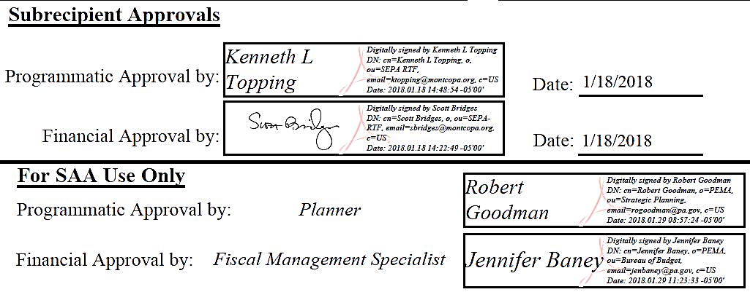
Digital ID Information
For PEMA web-based applications and PDF forms, we use both Electronic Signatures and Digital IDs
Adobe PDF forms use Digital IDs to sign the signature boxes
Digital IDs usually contain your name and email address, the name of the organization that issued it, country, date, and time
Notes:
For Digital IDs you can upload an image into your certificate ID as your signature or use a typed version of your name.
If you print a form out, sign it, scan it, and email it to us, that is an electronic signature that can only be verified with the original copy and not electronically.
PEMA prefers that forms are digitally signed but we do accept scanned ink signatures.
We will route forms manually if necessary and return the approval status with an attached copy of the form with all approval signatures for your files.

Slide 4
Creating a Digital ID in Adobe
Creating a Digital ID is easy regardless of the version of Adobe you are using:
Adobe Acrobat Standard/Pro or DC
Adobe Acrobat Reader XI or DC
Notes:
Current lineup of Acrobat products:
Acrobat Reader XI and DC
Acrobat Standard DC
Acrobat Pro DC
DC = Document Cloud
Document Cloud is an optional online service that can enhance the functionality of Acrobat Pro, Standard, and Reader.
****It’s also important to note that each form is set to be compatible with Adobe version 7.0 and later. This allows for signatures on multiple versions of Adobe.
“More often than not these days… when a form is transmitted electronically, many people still sign it by printing out a copy, signing it with a pen, scanning it again and then emailing the form back to the sender. It almost defeats the purpose of being able to complete the form on screen. Fortunately Reader offers a couple of options for getting your signature or a reasonable version of it onto the page without having to print it out and sign it by hand…”

Slide 5
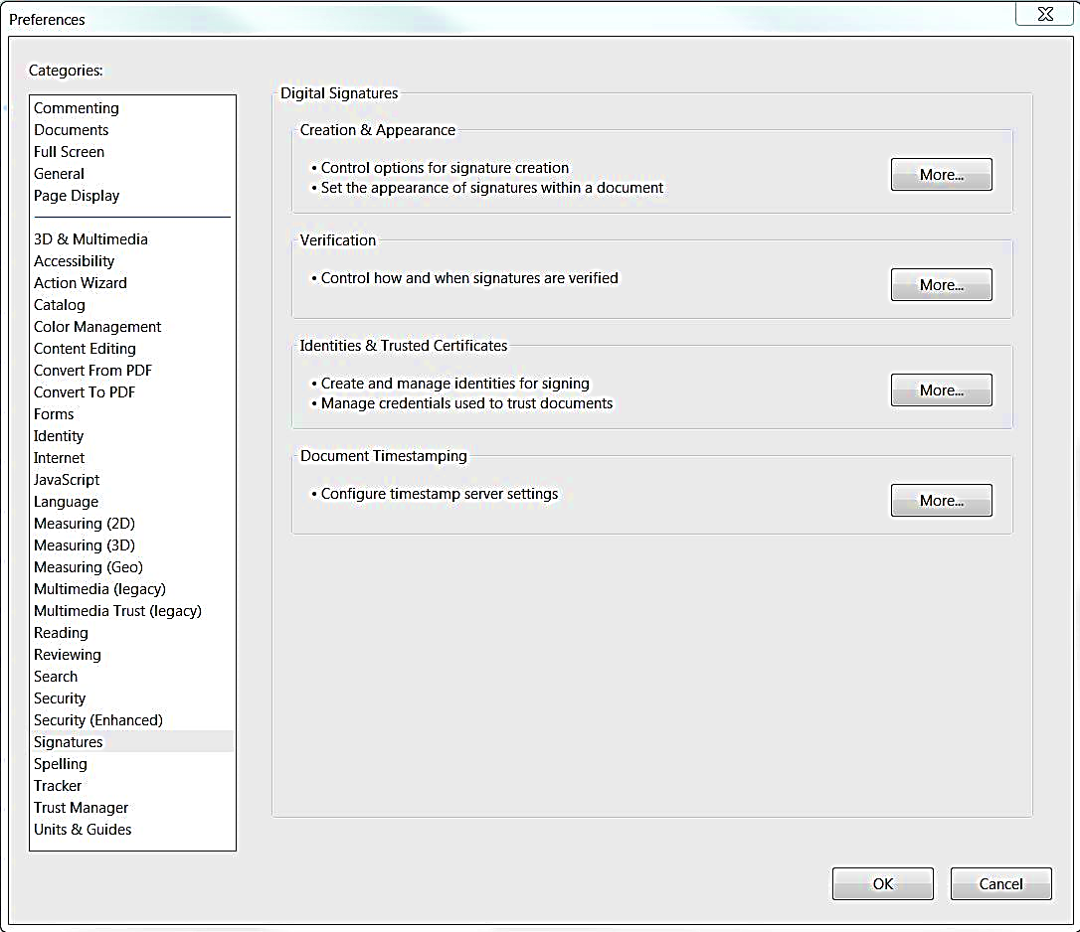
Creating a Digital ID in Adobe
Open Adobe Acrobat or Reader
Click on Edit in the menu bar-> Select Preferences -> Select Signatures in the side panel -> Then click on More… next to Identities & Trusted Certificates

Slide 6
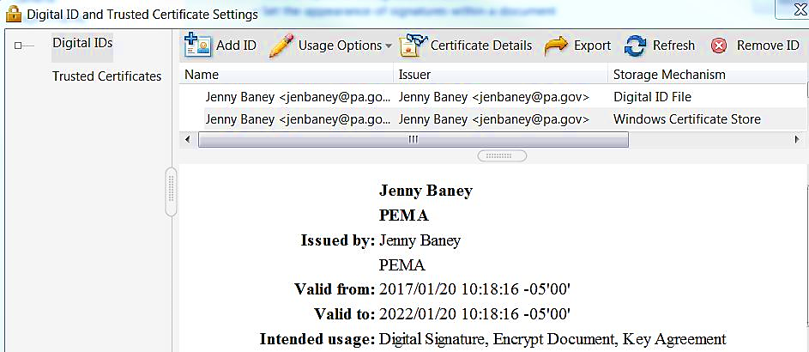
Creating a Digital ID in Adobe
Under Digital ID and Trusted Certificate Settings you can see your list of already created IDs or you can “Add ID”
You can also view Trusted Certificates, Certificate Details, and remove old/expired IDs if necessary
Under usage options on each signature, only select Use for Signing, never select Use for Certifying or Encryption

Slide 7
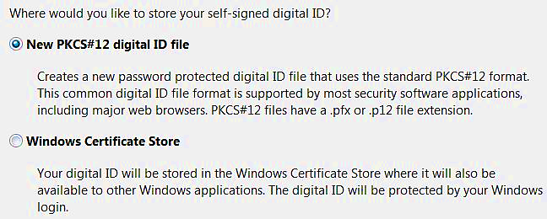
Creating a Digital ID in Adobe
Click on Add ID and select A new digital ID I want to create now, then click Next >
Choose where you would like to store your self-signed digital ID.
New PKCS#12 Digital ID file or Windows Certificate Store
Notes:
If you choose New PKCS#12 Digital ID file you will be required to supply a password. If you select this option, you will not be able to use this signature in other Windows Applications. For example, if you create a Digital ID under PKCS in Acrobat, you cannot use that signature to sign documents in Reader.
If you choose Windows Certificate Store, you are not required to enter a password. You can also use this signature in other applications.

Slide 8
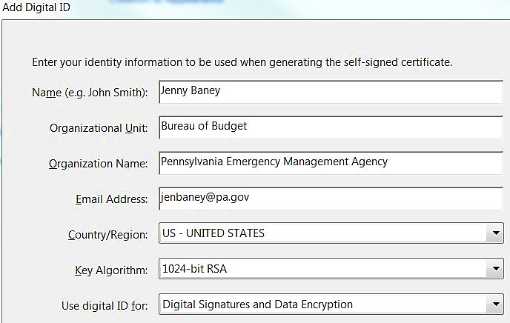
Creating a Digital ID in Adobe
Click Next > and Enter your identity information to be used when generating the self-signed certificate

Slide 9
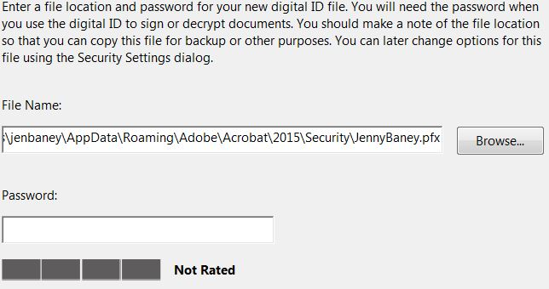
Creating a Digital ID in Adobe
If you select New PKCS#12 Digital ID file you will be required to supply a password and the following screen will pop-up after you enter your ID information
A File Name location will fill in automatically, you can change it or use the default at your discretion
Enter/confirm a password that is at least 6 characters long
You will be required to enter the password every time you sign a document if you select this option

Slide 10
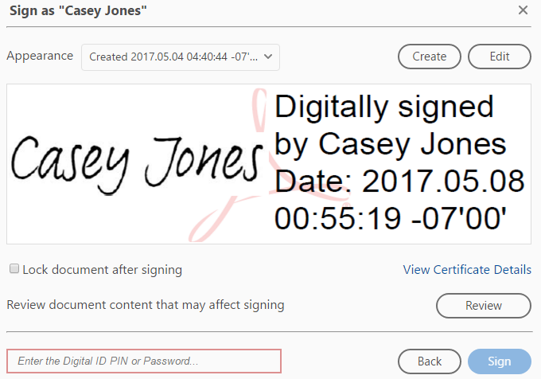
Signing PEMA DGM Forms
Once your Digital ID is created, click on the signature box in any form and it will digitally sign the document with your approval
Do not click “Lock document after signing”
Do not right click and “Certify with a Visible Signature”, as that prompts certification and locking of the form

Slide 11
Conclusion and Resources
Following these instructions will enable anyone to electronically or digitally sign any PDF form in the following Adobe versions:
Adobe Acrobat Standard/Pro or DC
Adobe Acrobat Reader XI or DC (including the free version)
Please use the following resources for any questions or concerns regarding electronic or digital signatures:
Adobe Help Center
Management Directive 210.12, Electronic Commerce Initiatives and Security
OA Information Technology Policies
Electronic Signature Policy
Electronic Signatures Reference Guide

