Slide 1
Lesson 3 Overview
The Delegation of Authority & Management by Objectives lesson introduces you to the delegation of authority process, implementing authorities, management by objectives, and preparedness plans and agreements.
Lesson Objectives
At the end of this lesson, you should be able to:
Describe the delegation of authority process.
Describe scope of authority.
Describe management by objectives.
Describe the importance of preparedness plans and agreements.

Slide 2
Delegation of Authority Process
Authority is a right or obligation to act on behalf of a department, agency, or jurisdiction.
In most jurisdictions, the responsibility for the protection of the citizens rests with the chief elected official. Elected officials have the authority to make decisions, commit resources, obligate funds, and command the resources necessary to protect the population, stop the spread of damage, and protect the environment.
The Authority Having Jurisdiction (AHJ) is the entity that creates and administers processes to qualify, certify, and credential personnel for incident-related positions. AHJs include state, tribal, or Federal government departments and agencies, training commissions, NGOs, or companies, as well as local organizations such as police, fire, public health, or public works departments.
In private industry, this same responsibility and authority rests with the chief executive officer.

Slide 3
Discussion Question
Within your jurisdiction or agency, who has the authority for protecting citizens and responding to incidents?

Slide 4
Scope of Authority
An Incident Commander's scope of authority is derived:
From existing laws, agency policies, and procedures, and/or
Through a delegation of authority from the agency administrator or elected official.

Slide 5
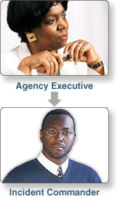
Delegation of Authority
The process of granting authority to carry out specific functions is called the delegation of authority. Delegation of authority:
Grants authority to carry out specific functions
Is issued by the chief elected official, chief executive officer, or agency administrator in writing or verbally
Allows the Incident Commander to assume command
Does NOT relieve the granting authority of the ultimate responsibility for the incident
Ideally, this authority will be granted in writing. Whether it is granted in writing or verbally, the authorities granted remain with the Incident Commander until such time as the incident is terminated, or a relief shift Incident Commander is appointed, or the Incident Commander is relieved of his or her duties for just cause.

Slide 6
Delegation of Authority: When Not Needed
A delegation of authority may not be required if the Incident Commander is acting within his or her existing authorities.
An emergency manager may already have the authority to deploy response resources to a small flash flood.
A fire chief probably has the authority (as part of the job description) to serve as an Incident Commander at a structure fire.

Slide 7
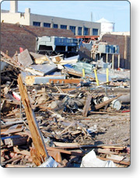
Delegation of Authority: When Needed
A delegation of authority is needed:
If the incident is outside the Incident Commander's jurisdiction
When the incident scope is complex or beyond existing authorities
If required by law or procedures

Slide 8
Discussion Question
When would an Incident Commander in your jurisdiction or agency need a delegation of authority?

Slide 9
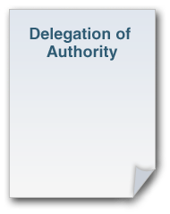
Delegation of Authority: Elements
When issued, delegation of authority should include:
Legal authorities and restrictions
Financial authorities and restrictions
Reporting requirements
Demographic issues
Political implications
Agency or jurisdictional priorities
Plan for public information management
Process for communications
Plan for ongoing incident evaluation
The delegation should also specify which incident conditions will be achieved prior to a transfer of command or release.

Slide 10
Discussion Question
What questions would you use to assess the effectiveness of incident management?

Slide 11
ACTIVITY 3.1: DELEGATING AUTHORITY
Activity Purpose: To identify and reinforce ways that incident management personnel can keep their agency executives involved and informed during an incident.
Time: 15 minutes
Instructions: Working in your team:
Read the case study in your Student Manual.
Identify the steps you would take to keep the agency executives involved in this incident.
List the steps on chart paper.
Case Study:
The Beltway sniper case was one of the most infamous crimes in recent law enforcement, instilling fear in thousands of people. According to the after-action report, communication was clearly the most compelling concern in the sniper case. Investigations of this kind succeed or fail based on executives ability to effectively manage and communicate information in a timely manner. Incident Commanders must balance the incident needs with the obligations of local executives to be responsive to their citizens. In the words of one police chief, You cannot expect leaders to stop leading.

Slide 12
Implementing Authorities
Within his or her scope of authority, the Incident Commander establishes incident objectives, then determines strategies, resources, and ICS structure based on the incident objectives. The Incident Commander must also have the authority to establish an ICS structure adequate to protect the safety of responders and citizens, to control the spread of damage, and to protect the environment.

Slide 13
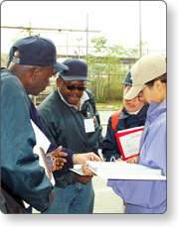
Management by Objectives
ICS is managed by objectives. Objectives are communicated throughout the entire ICS organization through the Incident Action Planning Process.
Management by objectives includes:
Establishing overarching objectives.
Developing and issuing assignments, plans, procedures, and protocols.
Establishing specific, measurable objectives for various incident management functional activities.
Directing efforts to attain them, in support of defined strategic objectives.
Documenting results to measure performance and facilitate corrective action.

Slide 14
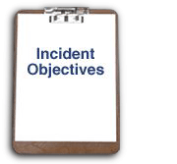
Establishing and Implementing Objectives
The steps for establishing and implementing incident objectives include:
Step 1: Understand agency policy and direction.
Step 2: Assess incident situation.
Step 3: Establish incident objectives.
Step 4: Select appropriate strategy or strategies to achieve objectives.
Step 5: Perform tactical direction.
Step 6: Provide necessary follow-up.

Slide 15
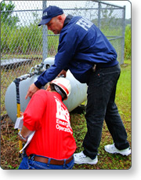
Initial Response: Conduct a Size-Up
In an initial incident, a size-up is done to set the immediate incident objectives. The first responder to arrive must assume command and size-up the situation by determining:
Nature and magnitude of the incident
Hazards and safety concerns
Hazards facing response personnel and the public
Evacuation and warnings
Injuries and casualties
Need to secure and isolate the area
Initial priorities and immediate resource requirements
Location of Incident Command Post and Staging Area
Entrance and exit routes for responders

Slide 16
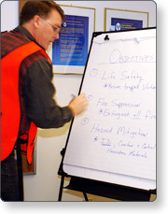
Overall Priorities
Throughout the incident, objectives are established based on the following priorities:
First Priority: Life Safety
Second Priority: Incident Stabilization
Third Priority: Property Preservation
Overall priorities for an incident define what is most important. These are not a set of steps, you do not complete all life safety actions before you start any efforts to stabilize the incident. Often these priorities will be performed simultaneously.

Slide 17
Effective Incident Objectives
For full effectiveness, incident objectives must be:
Specific and state what's to be accomplished
Measurable and include a standard and timeframe
Attainable and reasonable
In accordance with the Incident Commander's authorities
Evaluated to determine effectiveness of strategies and tactics
EXAMPLE: Establish a controlled perimeter around the incident within 45 minutes (by 6 p.m.)

Slide 18
ACTIVITY 3.2: ADDING INCIDENT OBJECTIVES
Activity Purpose: To give the students practice at developing incident objectives for a scenario.
Time: 20 minutes
Instructions: Working in your team:
Read the following scenario in your Student Manual.
Next, review the sample incident objectives
Determine what other incident objectives you would add for this incident.
List the objectives on chart paper and select a spokesperson.
Be prepared to present your additional objectives to the class in 5 minutes.
Scenario: At noon a sudden, severe windstorm strikes the city, uprooting trees, and trapping several commuters in their vehicles. Power is out to half of the city. Traffic is gridlocked. The storm has passed as quickly as it began.

Slide 19
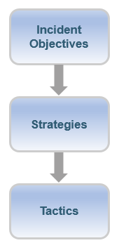
Objectives, Strategies, and Tactics
Incident objectives, strategies, and tactics are three fundamental pieces of a successful incident response.
Incident objectives state what will be accomplished.
Strategies establish the general plan or direction for accomplishing the incident objectives.
Tactics specify how the strategies will be executed.

Slide 20
Objectives, Strategies, and Tactics: Example
Objective: Stop the spread of hazardous materials from a tractor-trailer accident into the river by 1800 today.
Strategy: Employ barriers.
Tactic: Use absorbent damming materials to construct a barrier between the downhill side of the accident scene and Murkey Creek.
The Incident Commander is responsible for establishing goals and selecting strategies. The Operations Section, if it is established, is responsible for determining appropriate tactics for an incident.

Slide 21
Elements of an Incident Action Plan
An Incident Action Plan (IAP) covers an operational period and includes:
What must be done
Who is responsible
How information will be communicated
What should be done if someone is injured
The operational period is the period of time scheduled for execution of a given set of tactical actions as specified in the IAP.

Slide 22
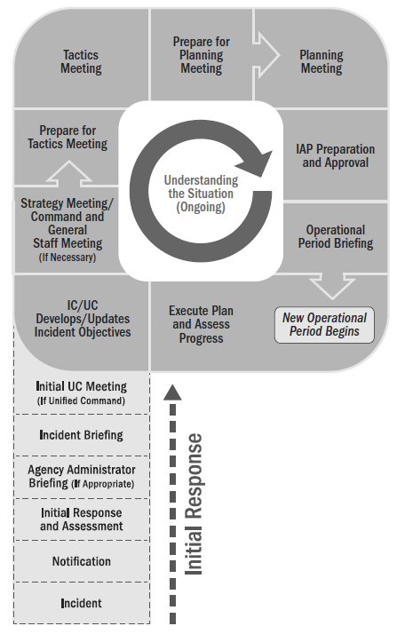
Operational Period Planning Cycle (Planning P)
The Incident Action Plan is completed each operational period utilizing the progression of meetings and briefings in the Operational Period Planning Cycle (Planning P). The Planning P is a graphical representation of the sequence and relationship of the meetings, work periods, and briefings that comprise the Operational Period Planning Cycle.

Slide 23
Discussion Question
Given this objective and strategy, what tactic would you use if heavy rains are threatening to cause a dam break?
Objective: Decrease the probability of flooding by reducing the reservoir level to 35 feet by 0800 tomorrow.
Strategy: Pump water from reservoir.
Tactics: _____________________________

Slide 24
Preparedness Plans and Agreements
The Incident Commander, as well as the Command and General Staffs, should have a working knowledge of jurisdictional and agency preparedness plans and agreements.
Preparedness plans may take many forms. The most common preparedness plans are:
Federal, State, or local Emergency Operations Plans (EOPs)
Standard operating guidelines (SOGs) - a standard indication or outline of policy
Standard operating procedures (SOPs) - a set of step-by-step instructions compiled by an organization to help workers carry out complex operations
Jurisdictional or agency policies

Slide 25
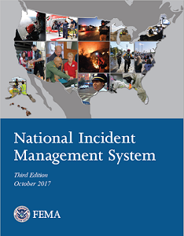
Emergency Operations Plan (EOP)
EOPs are developed at the Federal, State, and local levels to provide a uniform response to all hazards that a community may face.
EOPs should be consistent with the National Incident Management System (NIMS).
Visit this website to access the NIMS Resource Center: https://www.fema.gov/national-incident-management-system
Visit this website to access the Comprehensive Preparedness Guide (CPG) 101: A Guide for All-Hazard Emergency Operations Planning: https://www.fema.gov/pdf/about/divisions/npd/CPG_101_V2.pdf

Slide 26
Mutual Aid Agreements and Compacts
NIMS states that:
Mutual aid agreements establish the legal basis for two or more entities to share resources. Mutual aid agreements may authorize mutual aid between two or more neighboring communities, among all jurisdictions within a state, between states, between Federal agencies, and/or internationally.
Jurisdictions should be party to agreements with the appropriate jurisdictions and/or organizations from which they expect to receive, or to which they expect to provide, assistance.
Visit this website to review the Resource Management and Mutual Aid page within the NIMS Resource Center: https://www.fema.gov/resource-management-mutual-aid

Slide 27
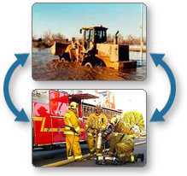
Mutual Aid Agreements and Compacts (Continued)
Mutual aid is the voluntary provision of resources by agencies or organizations to assist each other when existing resources are inadequate.
NIMS resource management describes how mutual aid allows jurisdictions to share resources among mutual aid partners.

Slide 28
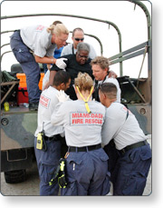
Mutual Aid and Assistance: All Levels
Mutual aid agreements and assistance agreements are used at all levels of government:
Local jurisdictions participate in mutual aid through agreements with neighboring jurisdictions.
States can participate in mutual aid through the Emergency Management Assistance Compact (EMAC).
Federal agencies offer mutual aid to each other and to States, tribes, and territories under the National Response Framework (NRF).

Slide 29
Information Derived from Plans
Plans may include information about:
Hazards and risks in the area
Resources in the area
Other formal agreements and plans
Contact information for agency administrators and response personnel
Other pertinent information

Slide 30
Discussion Question
What preparedness plans, agreements, and standard operating procedures must you follow in responding to incidents?

Slide 31
Lesson Completion
You have completed the Delegation of Authority & Management by Objectives lesson. You should now be able to describe:
The delegation of authority process.
Scope of authority.
Management by objectives.
The importance of preparedness plans and agreements.
The next lesson will discuss functional areas and positions.

