Slide 1
Lesson 6 Overview
The Organizational Flexibility lesson introduces you to flexibility within the standard ICS organizational structure.
Lesson Objectives
At the end of this lesson, you should be able to:
  Explain how the modular organization expands and contracts.
  Identify factors to consider when analyzing the complexity of an incident.
  Define the five types of incidents.

Slide 2
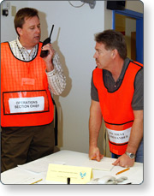
Flexibility and Standardization
A guiding principle of NIMS is flexibility. The ICS organization may be expanded easily from a very small size for routine operations to a larger organization capable of handling catastrophic events.
Standardization within ICS does NOT limit flexibility. ICS works for small, routine operations as well as catastrophic events.
Flexibility does NOT mean that the NIMS Management Characteristic Common Terminology is superseded. Flexibility is exercised only within the standard ICS organizational structure and position titles. Flexibility does not mean using non-standard organizational structures or position titles that would interfere with the NIMS Management Characteristics Common Terminology and Modular Organization.

Slide 3

Modular Organization
Incident command organizational structure is based on:
  Size and complexity of the incident
  Specifics of the hazard environment created by the incident
  Incident planning process and incident objectives

Slide 4

Discussion Question
Should an incident's ICS organizational structure include all General and Command Staff functions and positions at all times?

Slide 5

ICS Expansion and Contraction
Although there are no hard-and-fast rules, it is important to remember that:
  Only functions and positions that are necessary to achieve incident objectives are filled.
  Each activated element must have a person in charge.
  An effective span of control must be maintained.

Slide 6
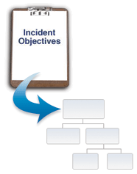
Activation of Organizational Elements
Many incidents will never require the activation of the entire Command or General Staff or entire list of organizational elements within each Section. Other incidents will require some or all members of the Command Staff and all sub-elements of each General Staff section.
The decision to activate an element (Section, Branch, Division, Group or Unit) must be based on incident objectives and resource needs.

Slide 7
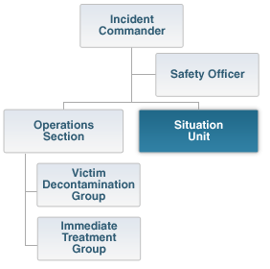
Activation of Organizational Elements (Continued)
An important concept is that many organizational elements may be activated in various Sections without activating the Section Chief.
For example, the Situation Unit can be activated without a Planning Section Chief assigned. In this case, the supervision of the Situation Unit will rest with the Incident Commander.

Slide 8
Discussion Question
Should you combine ICS positions and titles in order to save on staffing or achieve a higher level of efficiency?

Slide 9
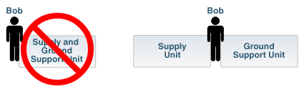
Avoid Combining Positions
It is tempting to combine ICS positions to gain staffing efficiency. Rather than combining positions, you may assign the same individual to supervise multiple units.
When assigning personnel to multiple positions, do not use nonstandard titles. Creating new titles may be unrecognizable to assisting or cooperating personnel and may cause confusion. Be aware of potential span-of-control issues that may arise from assigning one person to multiple positions.

Slide 10
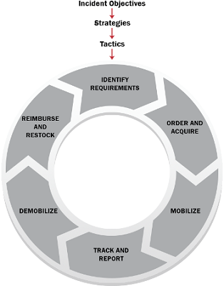
Resource Management
Maintaining an accurate and up-to-date picture of resource utilization is a critical component of incident management. The incident resource management process consists of the following:
  Identifying Requirements
  Ordering and Acquiring
  Mobilizing
  Tracking and Reporting
  Demobilizing
  Reimbursing and Restocking
This section of the lesson reviews key resource management principles.

Slide 11
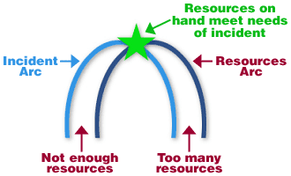
Anticipating Incident Resource Needs
Experience and training will help you to predict workloads and corresponding staffing needs. As the graphic illustrates, an incident may build faster than resources can arrive.
Eventually, a sufficient number of resources arrive and begin to control the incident. As the incident declines, resources then exceed incident needs. Remember that when resources increase or decrease you will have to reassess your organizational structure and staffing to determine if it is right-sized for the resources that are being managed.

Slide 12

Predicting Incident Workload
Incident workload patterns are often predictable throughout the incident life cycle. Several examples are provided below:
  Operations Section: The workload on Operations is immediate and often massive. On a rapidly escalating incident, the Operations Section Chief must determine appropriate tactics; organize, assign, and supervise resources; and at the same time participate in the planning process.
  Planning Section: The Resources and Situation Units will be very busy in the initial phases of the incident. In the later stages, the workload of the Documentation and Demobilization Units will increase.
  Logistics Section: The Supply and Communications Units will be very active in the initial and final stages of the incident.

Slide 13

Analyzing Incident Complexity
It is important to strike the right balance when determining resource needs. Having too few resources can lead to loss of life and property, while having too many resources can result in unqualified personnel deployed without proper supervision.
A complexity analysis can help:
  Identify resource requirements
  Determine if the existing management structure is appropriate

Slide 14
Complexity Analysis Factors
  Community and responder safety
  Impacts to life, property, and the economy
  Potential hazardous materials
  Weather and other environmental influences
  Likelihood of cascading events
  Potential crime scene (including terrorism)
  Political sensitivity, external influences, and media relations
  Area involved, jurisdictional boundaries
  Availability of resources

Slide 15
ACTIVITY 6.1: COMPLEXITY ANALYSIS
Activity Purpose: To give the students practice at identifying the indicators that are considered when analyzing and determining the complexity of an incident.
Time: 20 minutes
Instructions: Working in your team:
  Select an incident (e.g., flood, building collapse, water main break, bridge accident, hostage, hazardous materials, fire, disease outbreak, planned event, etc.). (Or you may want to assign an incident type to each team.)
  Using the worksheet in the Student Manual (see the next page), identify a list of indicators that you might consider in order to determine the complexity of this incident. List the top three critical factors on chart paper.
  Choose a spokesperson and be ready to present your complexity analysis to the class in 15 minutes.

Slide 16
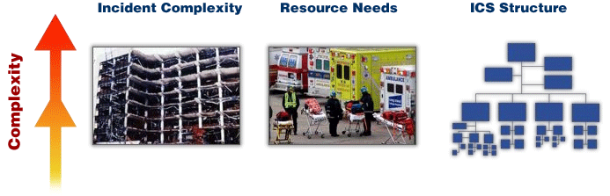
Incident Complexity and Resource Needs
As illustrated below, when incident complexity increases, your resource needs and ICS structure grow accordingly.

Slide 17

Resource Typing
Resource Typing defines and categorizes incident resources by capability. Typing is done to ensure that responders get the right personnel and equipment.
ICS resources are categorized by Capability, Category, Kind, and Type.
  Capability: The Core Capability or which a resource is most useful.
  Category: The function for which a resource is most useful.
  Kind: A description of what a resource is (personnel, teams, facilities, equipment or supplies).
  Type: The resource's minimum capability to perform its function. The level of capability is based on size, power and capacity (for equipment), or experience and qualifications (for personnel or teams).

Slide 18
Discussion Question
Which is a kind? Which is a type?
  Ordering a bus with seating for more than 40 adults is an example of ?
  Ordering a canine team is an example of ?

Slide 19

Importance of Resource Typing
Requesting a resource kind without specifying a resource type could result in an inadequate resource arriving on the scene.
The Order: "We need a HazMat team."

Slide 20
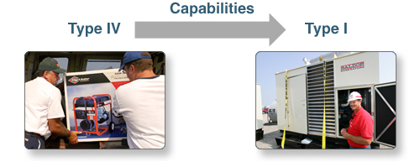
Resource Typing (Continued)
Resource types range from Type I (most capable) to Type IV (least capable), letting you reserve the appropriate level of resource for your incident by describing the size, capability, and staffing qualifications of a specific resource.

Slide 21

Resource Typing and NIMS
Resource Management is a key component of NIMS. This effort helps all Federal, State, tribal, and local jurisdictions locate, request, and track resources to assist neighboring jurisdictions when local capability is overwhelmed.
The Resource Typing Library Tool (RTLT) is an online catalogue of national resource typing definitions, position qualifications and Position Task Books (PTBs) provided by the Federal Emergency Management Agency (FEMA).
For more information you can access the RTLT at https://rtlt.preptoolkit.fema.gov.

Slide 22
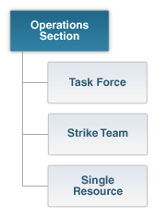
Additional Resource Terminology
The following terms apply to resources:
  A Task Forceis a combination of mixed resources with common communications operating under the direct supervision of a Task Force Leader.
  A Strike Team / Resource Team is a set number of resources of the same kind and type with common communications operating under the direct supervision of a Strike Team Leader. A Strike Team may also be referred to as a Resource Team by law enforcement.
  A Single Resource is an individual, a piece of equipment and its personnel complement, or a crew or team of individuals with an identified work supervisor that can be used on an incident.

Slide 23
Discussion Question
Which of these is Strike (Resource) Team? Task Force? Single Resource?
  Five Type I ambulances and crew complements with a leader.
  One Type I ambulance and crew complement.
  One Type III Helicopter, one Urban Search & Rescue Team, and one Emergency Medical Technician with a leader.

Slide 24

Incident Typing: Overview
Incidents, like resources, may be categorized into five types based on complexity. Type 5 incidents are the least complex and Type 1 the most complex. Incident typing may be used to:
  Make decisions about resource requirements.
  Order Incident Management Teams (IMTs). An IMT is made up of the Command and General Staff members in an ICS organization.

Slide 25
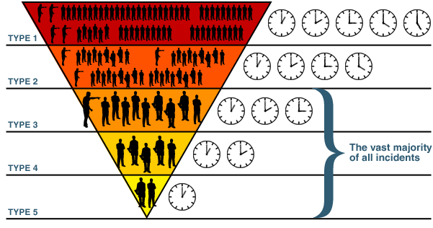
Incident Typing: Overview (Continued)
The incident type corresponds to both the number of resources required and the anticipated incident duration. The incident types move from Type 5 being the least complex to Type 1 being the most complex. As the number of resources required gets larger and the duration of the incident gets longer, the complexity increases. The vast majority of incidents are in the Type 3-5 range.Clocks do not depict length of incident time.

Slide 26
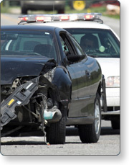
Type 5 Incident
Characteristics of a Type 5 Incident are as follows:
  Resources: One or two single resources with up to six personnel. Command and General Staff positions (other than the Incident Commander) are not activated.
  Time Span: Incident is contained within the first operational period and often within a few hours after resources arrive on scene. No written Incident Action Plan is required.
Examples include a vehicle fire, an injured person, or a police traffic stop.

Slide 27
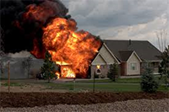
Type 4 Incident
Characteristics of a Type 4 Incident are as follows:
  Resources:Command Staff and General Staff functions are activated (only if needed). Several single resources are required to mitigate the incident.
  Time Span: Limited to one operational period in the control phase. No written Incident Action Plan is required for non-HazMat incidents. A documented operational briefing is completed.

Slide 28
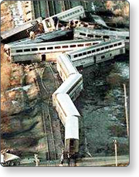
Type 3 Incident
Characteristics of a Type 3 Incident are as follows:
  Resources: When capabilities exceed initial response, the appropriate ICS positions should be added to match the complexity of the incident. Some or all of the Command and General Staff positions may be activated, as well as Division or Group Supervisor and/or Unit Leader level positions. An Incident Management Team (IMT) or incident command organization manages initial action incidents with a significant number of resources, and an extended response incident until containment/control is achieved.
  Time Span: The incident may extend into multiple operational periods and a written Incident Action Plan may be required for each operational period.

Slide 29
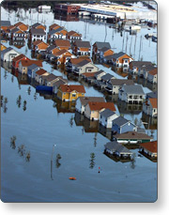
Type 2 Incident
Characteristics of a Type 2 Incident are as follows:
  Resources: Regional and/or national resources are required to safely and effectively manage the operations. Most or all Command and General Staff positions are filled. Operations personnel typically do not exceed 200 per operational period and the total does not exceed 500. The agency administrator/official is responsible for the incident complexity analysis, agency administrator briefings, and written delegation of authority.
  Time Span: The incident is expected to go into multiple operational periods. A written Incident Action Plan is required for each operational period.

Slide 30

Type 1 Incident
Characteristics of a Type 1 Incident are as follows:
  Resources: National resources are required to safely and effectively manage the operations. All Command and General Staff positions are activated, and Branches need to be established. Operations personnel often exceed 500 per operational period and total personnel will usually exceed 1,000. There is a high impact on the local jurisdiction, requiring additional staff for office administrative and support functions. The incident may result in a disaster declaration.
  Time Span: The incident is expected to go into multiple operational periods. A written Incident Action Plan is required for each operational period.

Slide 31

Incident Management Teams (IMTs)
IMTs are rostered groups of ICS-qualified personnel consisting of an Incident Commander, other incident leadership, and personnel qualified for other key ICS positions. An IMT may be used to respond to an incident. IMTs include Command and General Staff members. IMT types correspond to incident type and include:
  Type 5: Local Village and Township Level
  Type 4: City, County, or Fire District Level
  Type 3: State, Territory, Tribal, or Metropolitan Area Level
  Type 2: National and State Level
  Type 1: National and State Level (Type 1 Incident)
Team members are certified as having the necessary training and experience to fulfill IMT positions.

Slide 32
ACTIVITY 6.2: INCIDENT TYPES
Activity Purpose: To give students practice at determining incident types for various scenarios.
Time: 15 minutes
Instructions: Working with your team:
  Review the facts presented about the five incident scenarios in your Student Manual.
  Determine the incident type.
  Choose a spokesperson and be ready to list the incident types for each scenario in 10 minutes.
Note: A table summarizing characteristics of each type is provided after the scenarios.

Slide 33
Lesson Completion
You have completed the Organizational Flexibility lesson. You should now be able to:
  Explain how the modular organization expands and contracts.
  Identify factors to consider when analyzing the complexity of an incident.
  Define the five types of incidents.
The next lesson will cover transfer of command.

